Slide 1
Young’s restaurant
20161512 Young Ho Kim

Slide 2
Purpose
This website is for advertising and promotion purposes.

Slide 3
filename | Site Map | Date | 2019-12-13
title | Site Map | Writer | Young Ho Kim
 |  |  | Content Description
 |  |  | .
Young’s Restaurant
introduction
menu
Location &
Contact information
reservation
history
steak
application
Address &
Tel num
employee
pasta
pilaf
beverage

Slide 4
filename | Main Page | Date | 2019-10-29
title | Main Page (Must use elements of HTML Document Structure ) | Writer | Young Ho Kim
 |  |  | Fixed things
 |  |  | This is the main page design, I created before I started the project. The difference here is that I removed the header part and replaced the background with an image.
Young’s restaurant(header)
Introduction
Menu
Location & Contact information
Reservation
(nav)
image

Slide 5
filename | Others | Date | 2019-12-13
title | Other | Writer | Young Ho Kim
 |  |  | Fixed things
 |  |  | This is a design for all other pages except the main page before I started project. The difference between the previous and the present is that I have removed the aside parts and used dropdowns, put elements(aside) in the nav part.
Something
Introduction
Menu
Location & Contact information
Reservation
(nav)
Comments & images
History
Chef
(aside)

Slide 6
Problem
I wanted to share my page with others and get feedback as I made my project. So, I found a way to find the GitHub site.

Slide 7
GitHub
GitHub is a web hosting service that supports projects using Git, a distributed version control tool. GitHub offers both commercial services and free services for open source
https://youngho1234.github.io/young-s/

Slide 8
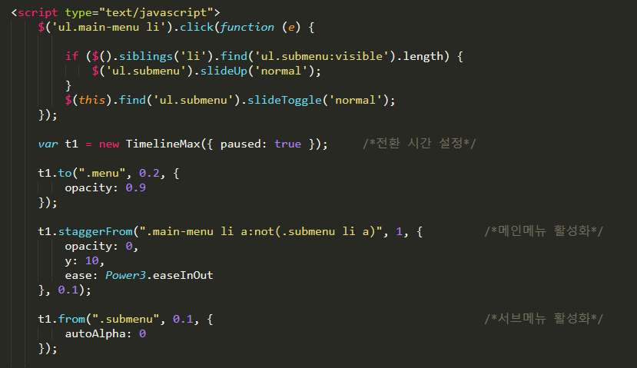
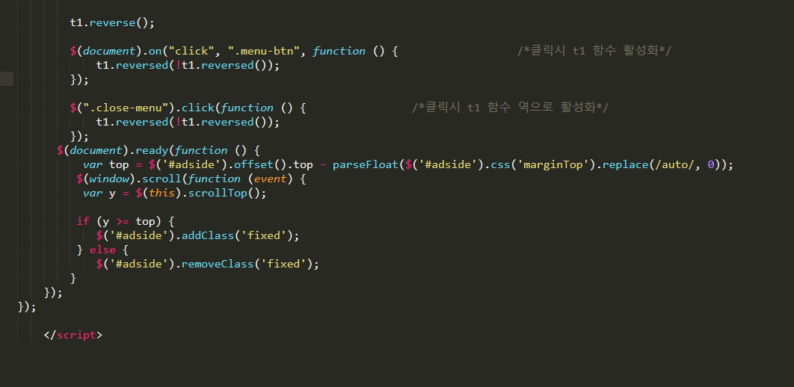
Drop down Code

Slide 9
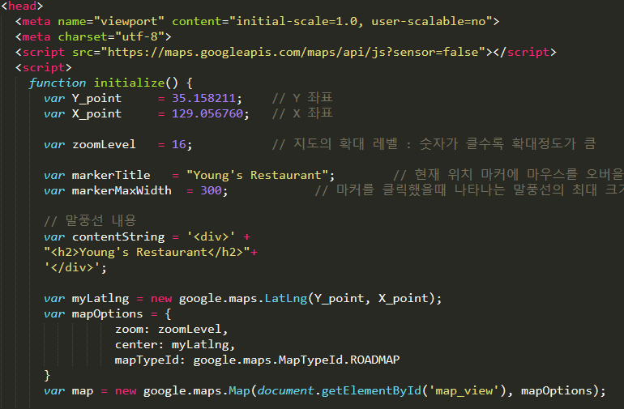
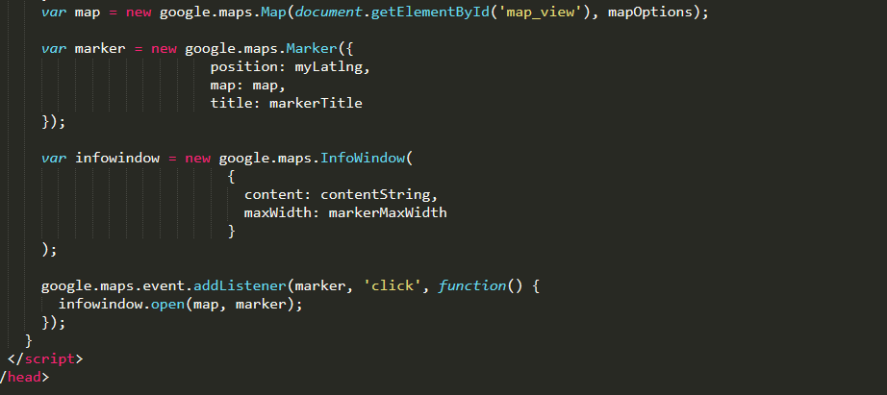
Google map Code

Slide 10
Thank You

